Slide 1
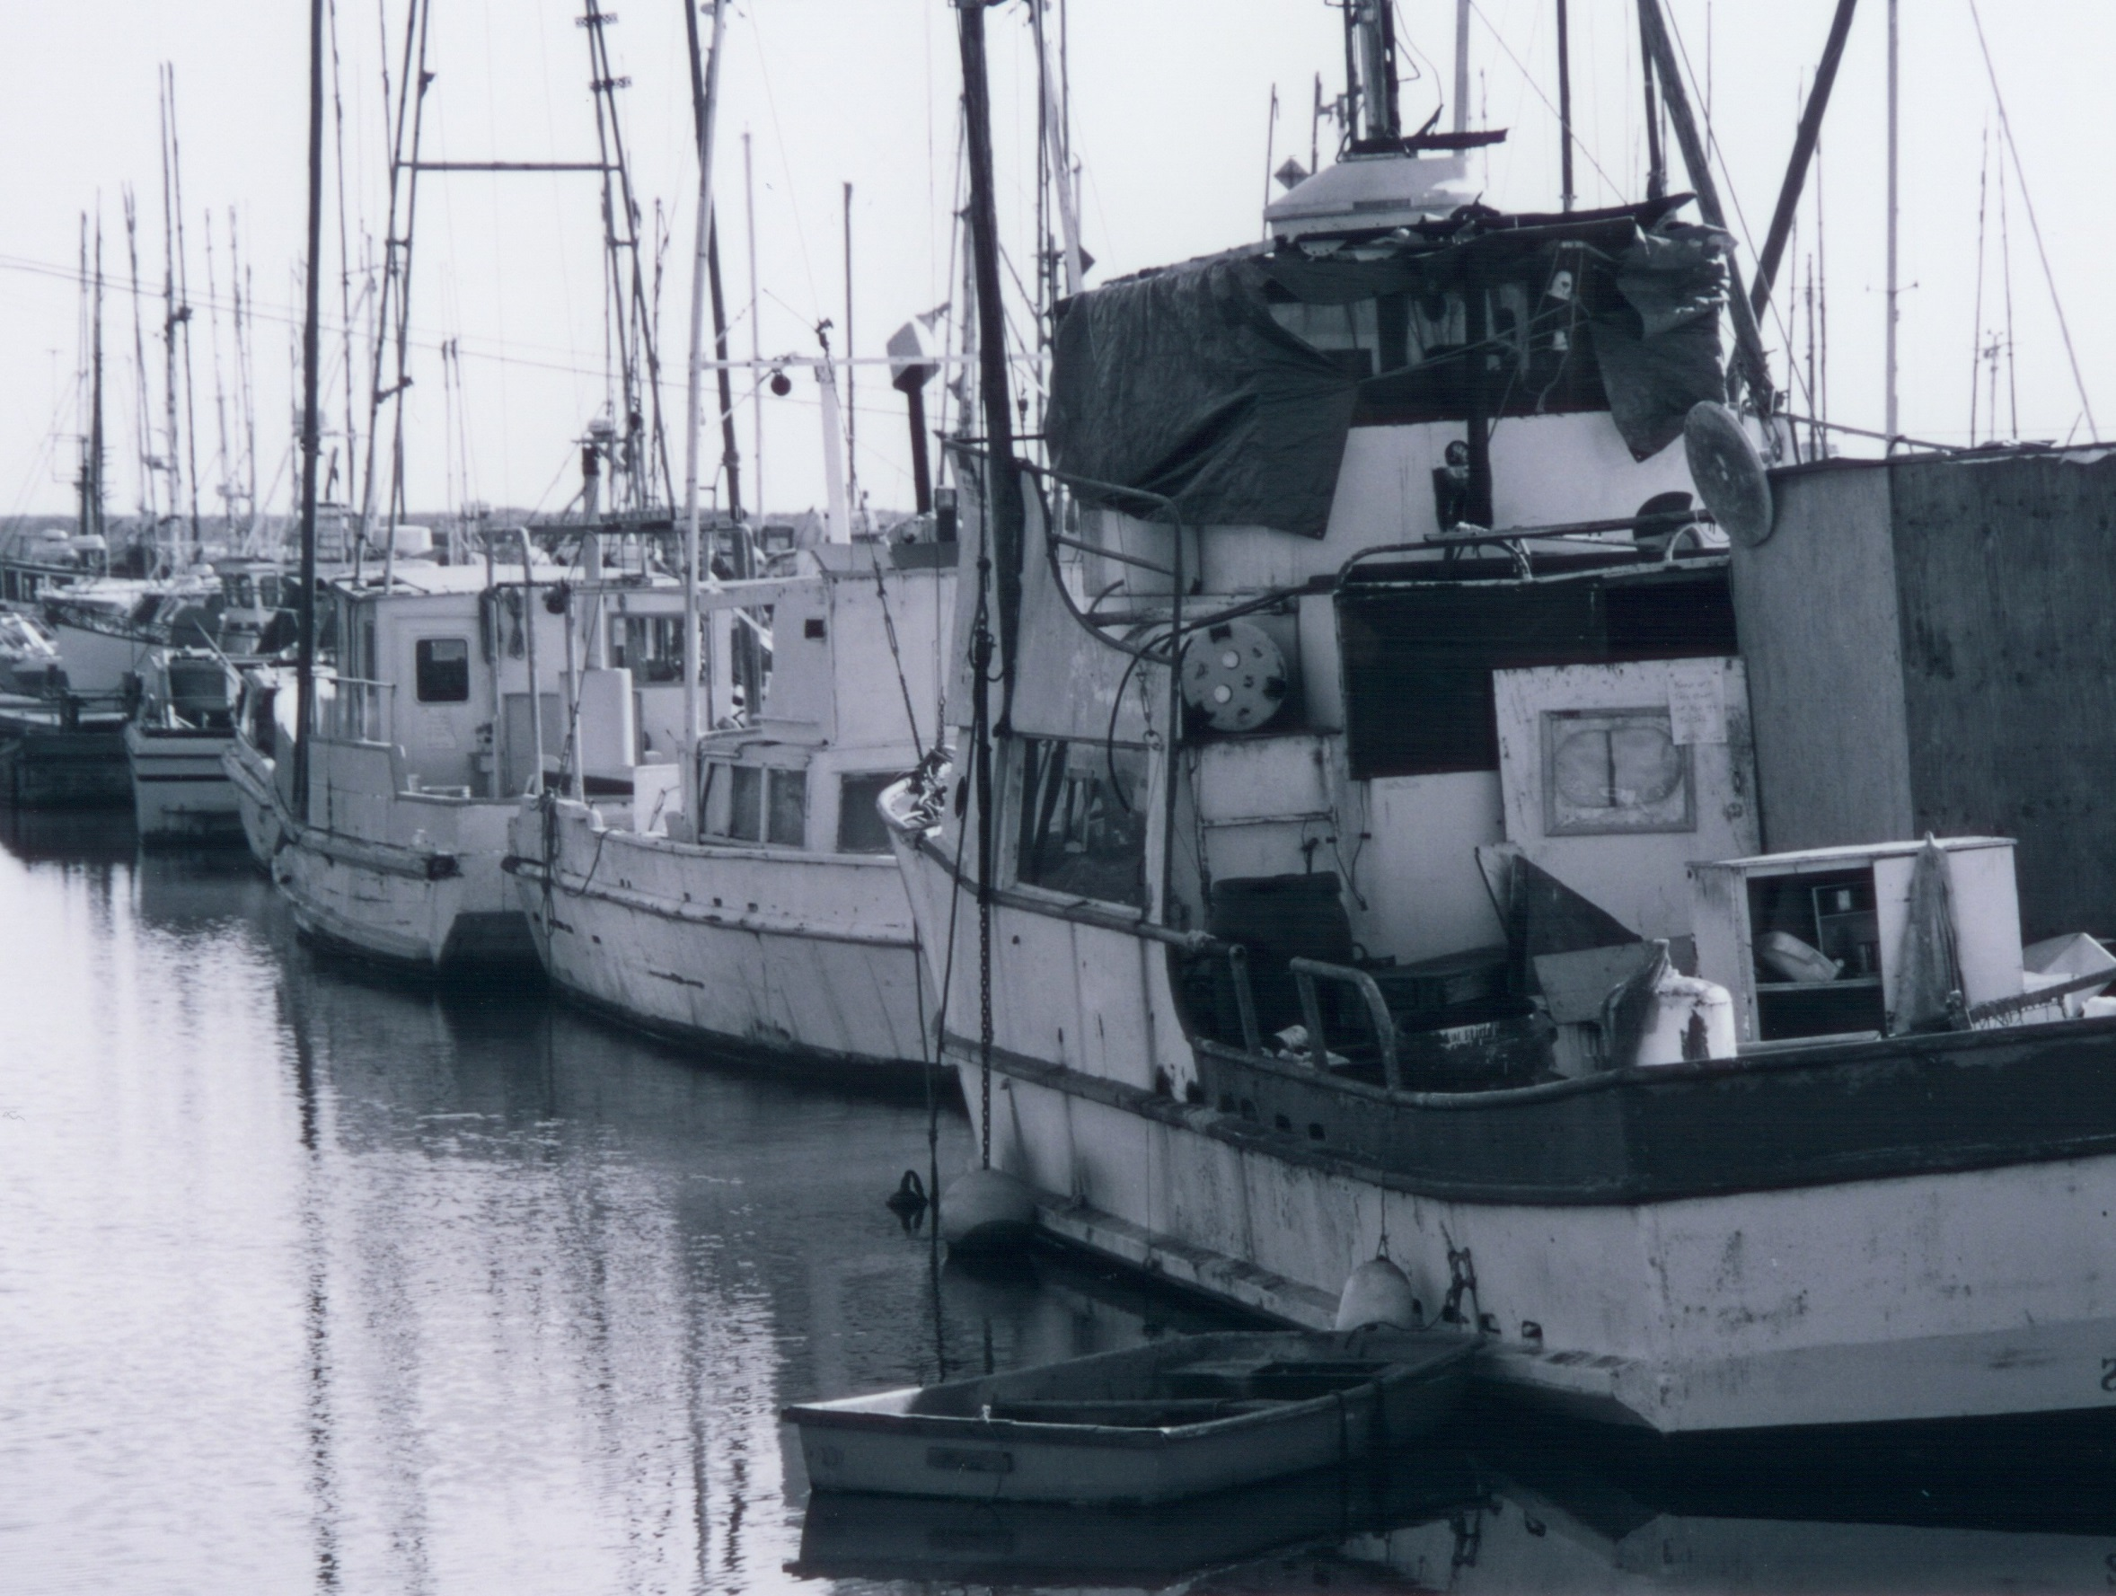
Understanding fishing communities through participation networks
Jameal Samhouri
Mary Fisher, Chris Harvey, Dan Holland, Kelly Andrews, Karma Norman, Amanda Phillips

Slide 2
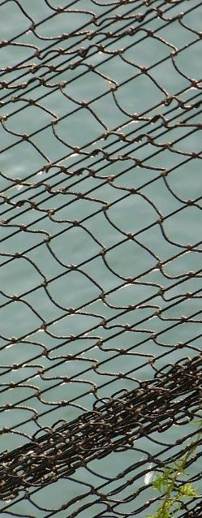
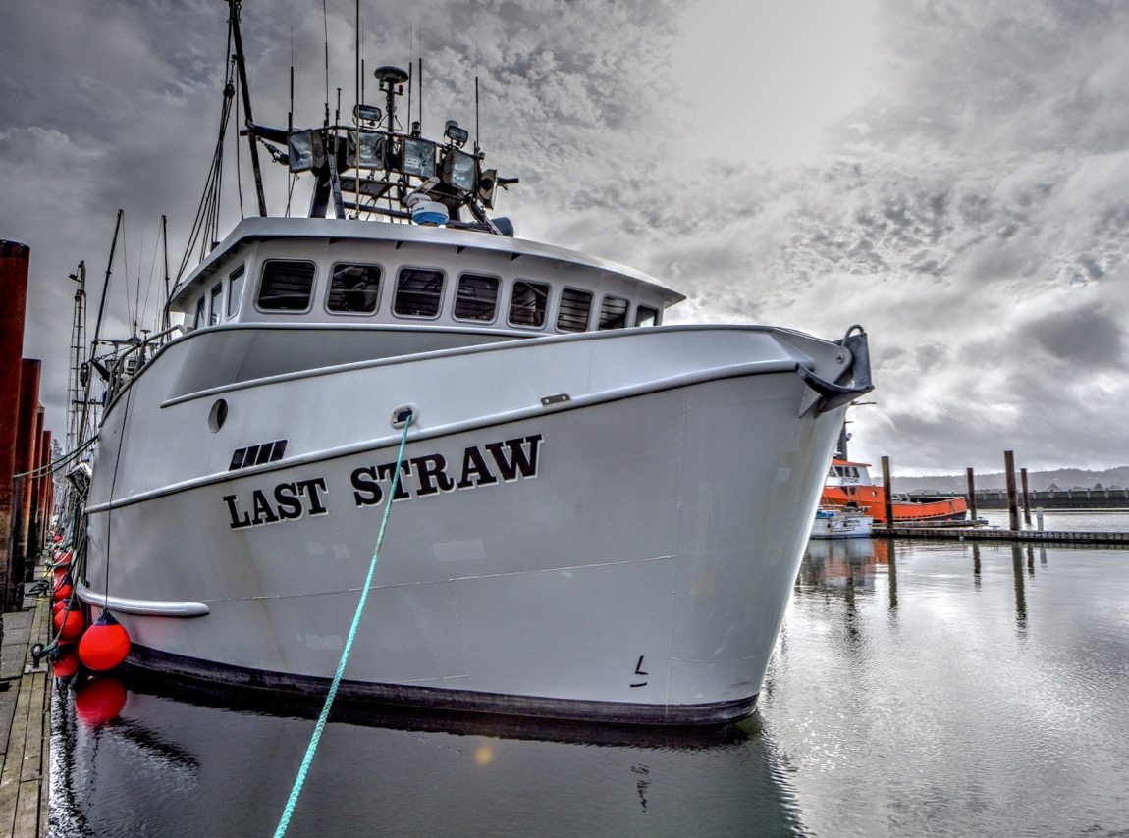
Human activities and wellbeing
Ken Gagne

Slide 3
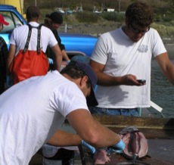
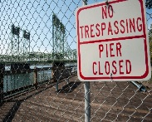
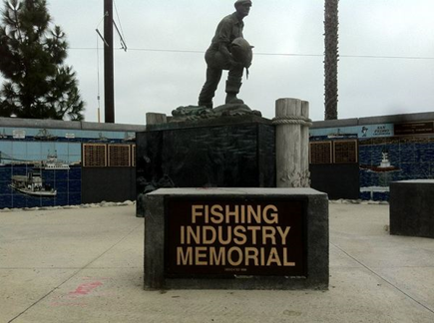
A need for deeper information on fishing communities
EAS and EWG: have asked What positions a fishing community to be vibrant and sustainable? How can we better describe important fisheries for west coast communities?
ESR characterizes social and economic indicators to inform implementation of National Standard 8
Aligns with EBFM Policy
Notes:
EAS – March 2019, Mar 2020, Sep 2020
Council staff request. Kit Dahl – based on EAS/EWG
EAS: desire to understand infrastructure, what positions them to be a vibrant and sustainable community. “fabric” (March 2019)
IN the future we want the ESR to better characterzue social and economic indicators for sake of due diligience on NS8
EAS March 2020: Suggest expanded info about viability and vulnerability of specific ports. Total catch by port for each fishery on a map

Slide 4
Fisheries participation networks provide a window into how people in a place are connected to the ocean
Note: fisheries participation networks reviewed by SSC-ES in Sept 2016
Fuller, Samhouri, et al. 2017 ICESJMS
Also see Frawley et al. 2020 F&F
Notes:
Fig. 1. Human connectivity of commercial fisheries in the California Current Ecosystem. Fisheries in the California Current are strongly connected by human participation. Some fisheries, notably the Dungeness crab-pot fishery, dominate the coast-wide network. The human connections among fisheries also frequently connect ecologically distant species, i.e. Dungeness crab and albacore tuna or benthic groundfish and pink shrimp. Examining networks generated for port groups on the right, we find that these networks vary in the number of fisheries (nodes) and strength of interconnections. These differences in structure may correspond to differences in community resilience. We color ports using one potential metric of network resilience to highlight this heterogeneity (see supplementary materials for additional metrics). On the right port groups are colored by their adaptive capacity and show port-level participation networks with nodes colored by management jurisdiction (federally managed fisheries are blue, state managed are red, fisheries where both state and federal have a role in management, i.e. nearshore rockfish, are purple). For visual clarity we only include fisheries that had at least 3 vessels participating, and accounted for, on average, 25% of a vessel’s annual income (Materials and methods are available as supplementary materials at the Science website).

Slide 5
Visualizing connectivity among fisheries with networks
Nodes representative color-coded target species or species groups
Node size indicates amount of revenue
Edges (lines connecting) indicate vessels participating in pairs of fisheries (cross-fishery participation)
Edge width scales with number of vessels

Slide 6
More on methods
Analyzed fish ticket data from 2004-2020
Focused on crab years Nov of year y to Oct of year (y + 1)
Focused on fisheries with >=3 vessels participating in a port group in a year
A given fishery must contribute to at least 10% of a vessel's seasonal revenue to be included in the network data
Species grouped as with diversification indices in ESR
Ports grouped as with Thiell Index (IOPAC groups)
Methods and code otherwise follow Fisher et al. 2021 PNAS
Notes:
Species groups:
IOPAC: 21 groups

Slide 7
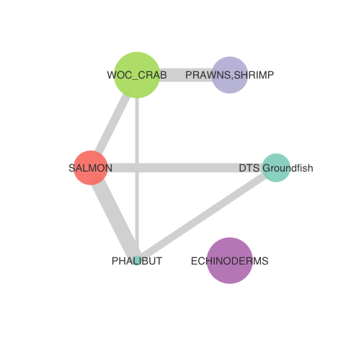
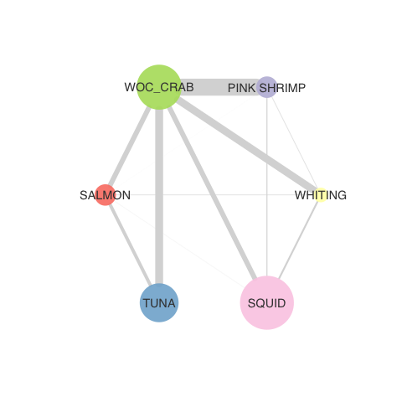
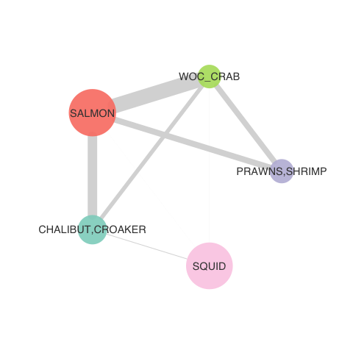
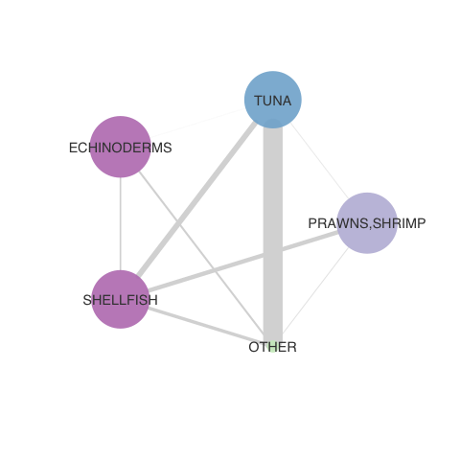
2019-2020 fisheries participation networks (by IOPAC port group)
North Washington Coast
Newport
Monterey
San Diego

Slide 8
Horizons
Cluster port groups to identify representative ports to highlight in ESR (eg, using MDS as in Fisher et al. 2021)
Consider different species groupings
Based on CVA high vs low ranks
Metier analysis
Assess changes in time series of networks (and derived metrics) in relation to perturbations
Eg, Pre and post catch shares
Eg, Pre/during/post covid

Slide 10
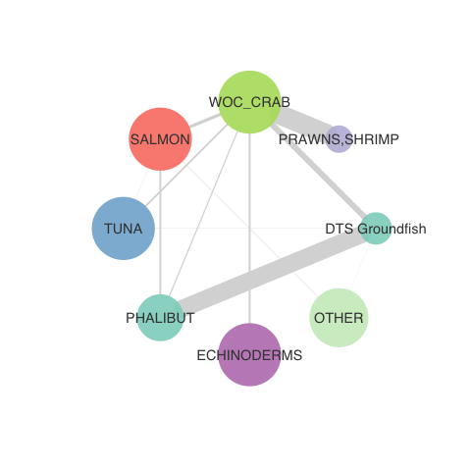
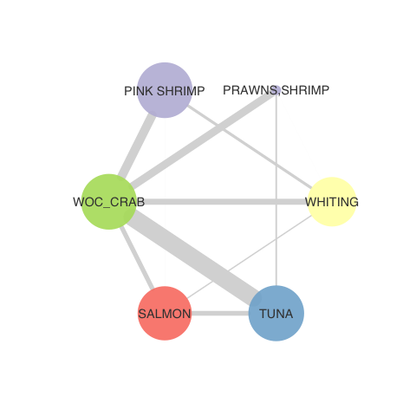
North Washington Coast
Puget Sound
Washington Coast

Slide 11
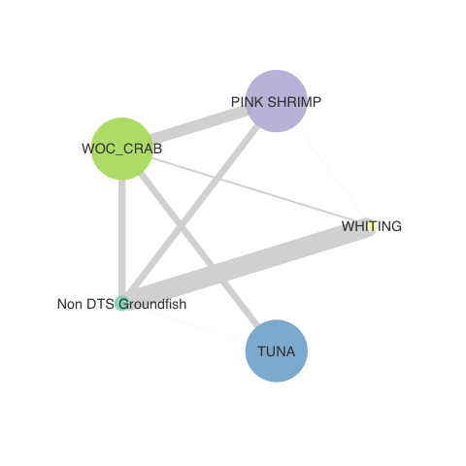
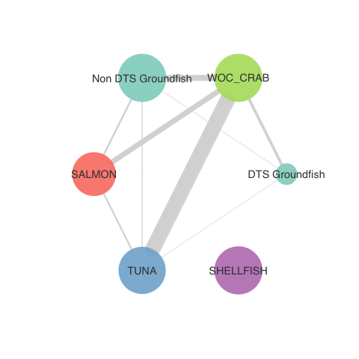
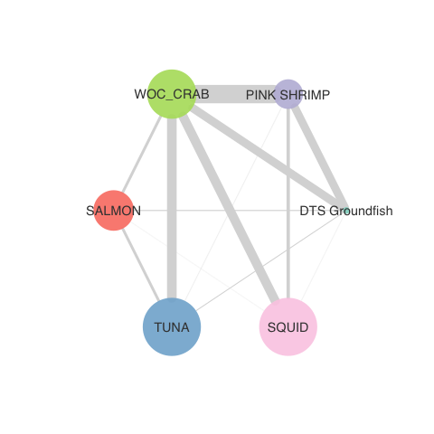
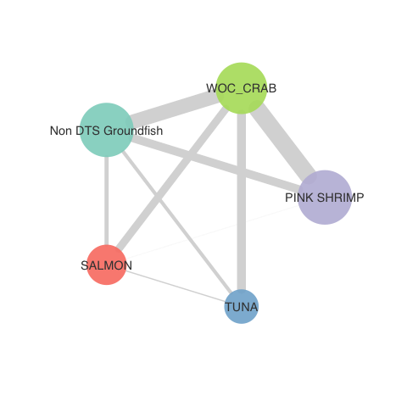
Astoria
Tillamook
Newport
Coos Bay
Brookings

Slide 12
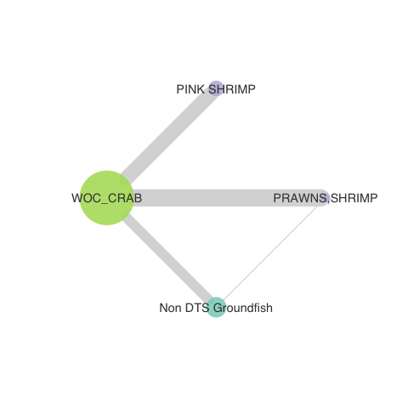
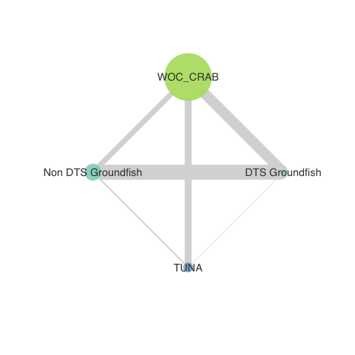
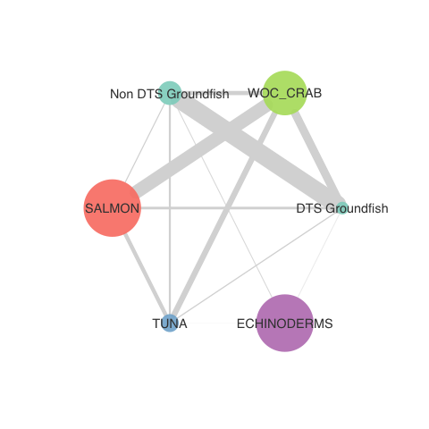
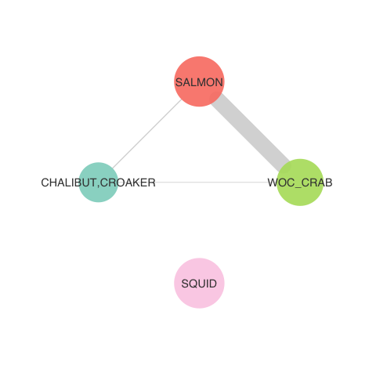
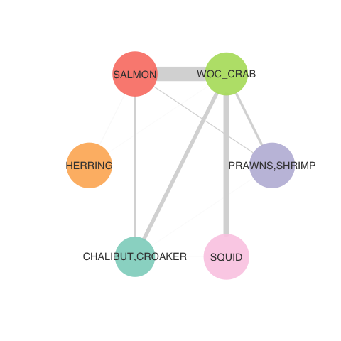
Crescent City
Eureka
Fort Bragg
Bodega Bay
San Francisco

Slide 13
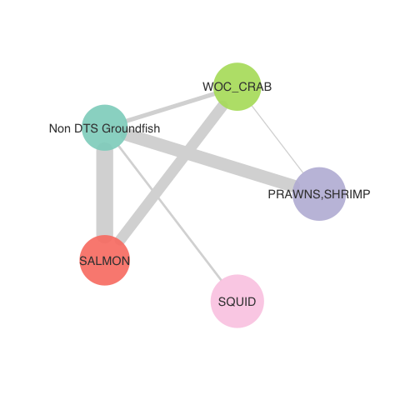
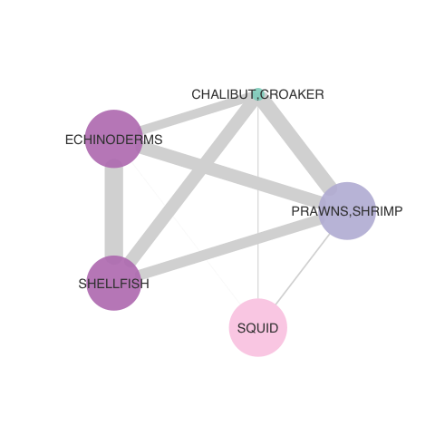
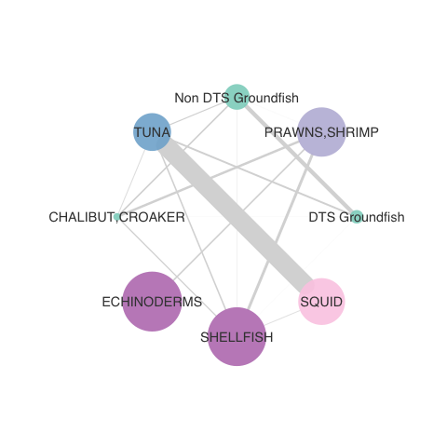
Monterey
Morro Bay
Santa Barbara
Los Angeles
San Diego

Slide 14
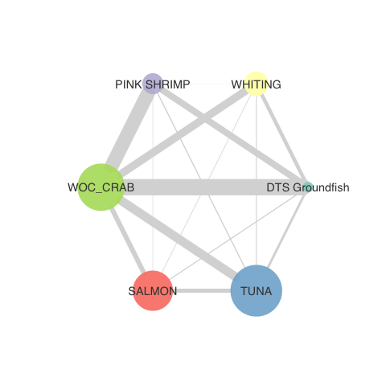
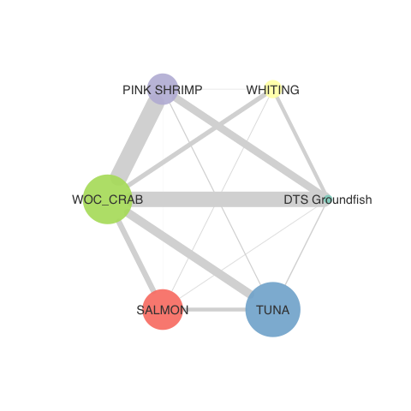
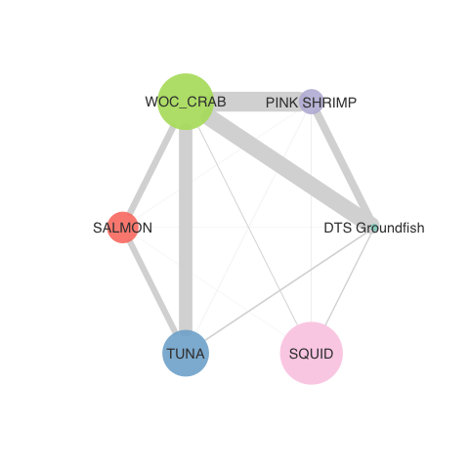
Newport over time: less connected?
2016-17
2017-18
2018-19
2019-2020
Notes:
DEPOE BAY, SILETZ BAY, NEWPORT, NEWPORT AREA PORTS, WALDPORT, YACHATS

Slide 15
Newport over time
2016-17
2017-18
2018-19
2019-2020
Notes:
DEPOE BAY, SILETZ BAY, NEWPORT, NEWPORT AREA PORTS, WALDPORT, YACHATS
Relationship between diversification and networks, changes in diversification not nec a result of cross-fishery participation because these calculations consider the port that entity (ie, diversification is based on aggregate at comm level, not indiv vessel level)
Would be interesting to base node size on # vessels and edge width on….
Are there big diffs between eg, 2004 and 2019?

Slide 16
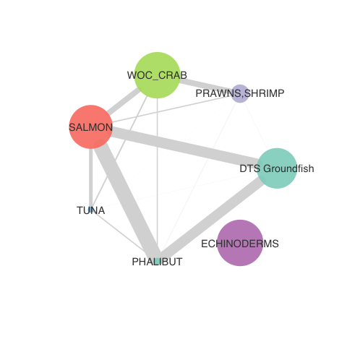
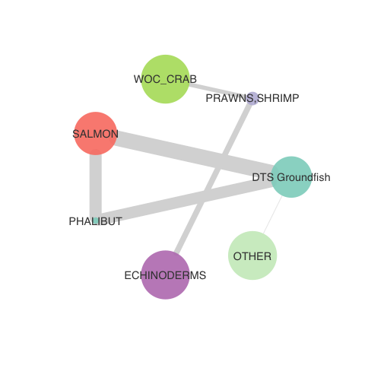
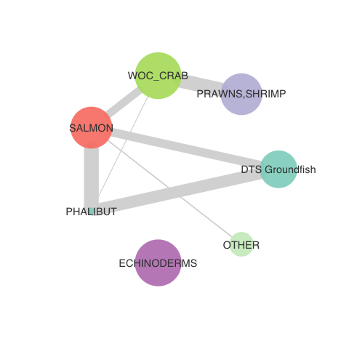
North WA Coast over time: less connected?
2016-17
2017-18
2018-19
2019-2020
Notes:
NEAH BAY, PORT TOWNSEND, PORT ANGELES, SEQUIM, LA PUSH

Slide 17
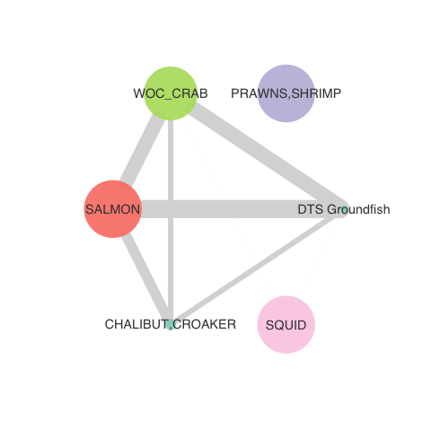
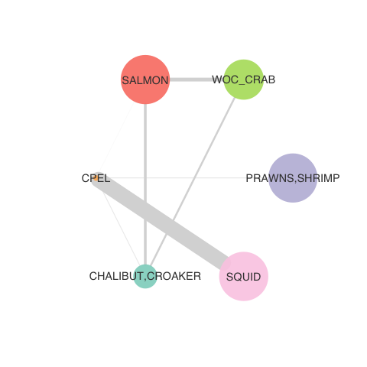
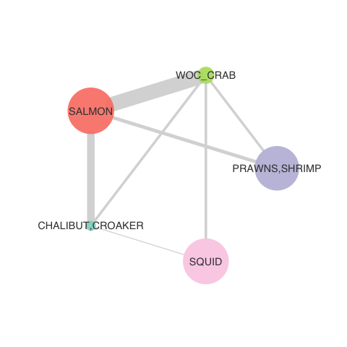
Monterey over time: variable?
2016-17
2017-18
2018-19
2019-2020
Notes:
BIG CREEK, SANTA CRUZ, OTHER SANTA CRUZ AND MONTEREY COUNTY PORTS, MOSS LANDING,
MONTEREY AREA PORTS, MONTEREY

Slide 18
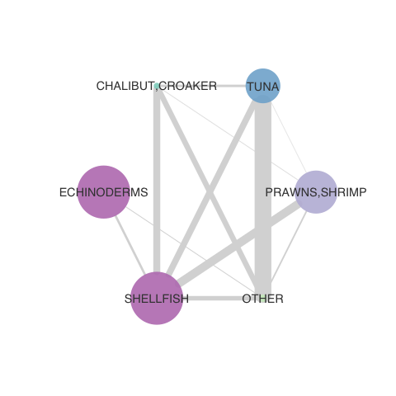
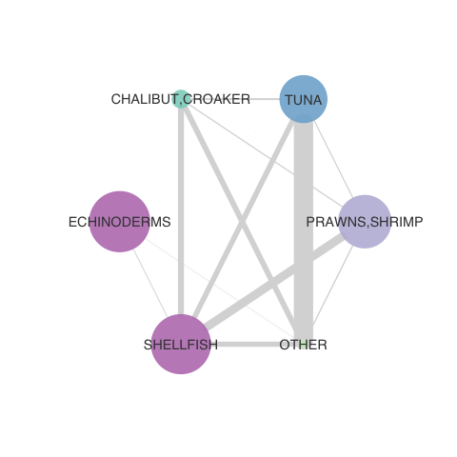
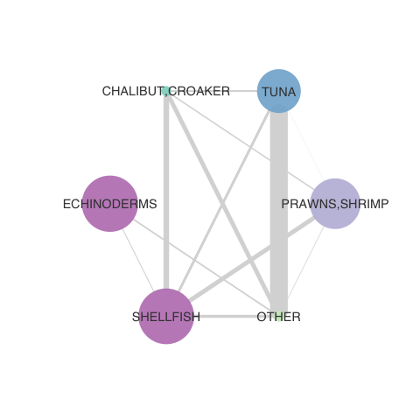
San Diego over time: consistent, ‘but?
2016-17
2017-18
2018-19
2019-2020
Notes:
OTHER SAN DIEGO COUNTY PORTS, SAN DIEGO, SAN DIEGO AREA PORTS, OCEANSIDE

Slide 19
16 species groups (fisheries)
DTS groundfish | Prawns,shrimp | Tuna
Whiting | Pink shrimp | Herring
Non DTS groundfish | Woc_crab | Cpel
Skate,dogfish,shark | Salmon | Phalibut
Chalibut,croaker | Echinoderms | Shellfish
Other
Notes:
This grouping is intermediate, strongest correlation with CV revenue over time compared to other groupings

Slide 20
 | High | Low
Node Count | 9 | 1
Edge Density | 1 | 0
Modularity | 1 | -1
Network Centralization | 1 | -1

Slide 21
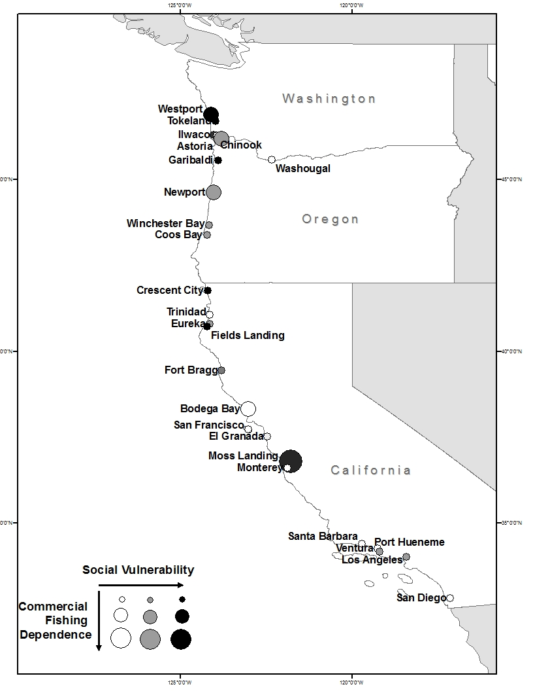
Conservation and management measures shall…take into account the importance of fishery resources to fishing communities…
Notes:
In fisheries, we have laws that recognize this coupling
Conservation and management measures shall, consistent with the conservation requirements of this Act (including the prevention of overfishing and rebuilding of overfished stocks), take into account the importance of fishery resources to fishing communities… in order to (A) provide for the sustained participation of such communities, and (B) to the extent practicable, minimize adverse economic impacts on such communities.
http://www.fisheries.noaa.gov/sfa/laws_policies/national_standards/index.html

Slide 22
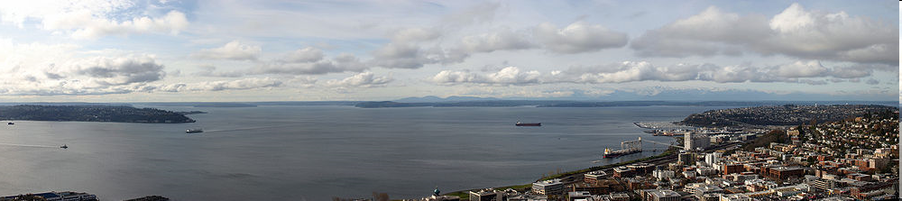
Federal Register 16 U.S.C. 1802 §3 (16)
Notes:
The term "fishing community" means a community which is substantially dependent on or substantially engaged in the harvest or processing of fishery resources to meet social and economic needs, and includes fishing vessel owners, operators, and crew and United States fish processors that are based in such community. 16 U.S.C. 1802 §3 (16).
Definition of commnunity: a group of people with diverse characteristics who are linked by social ties, share common perspectives, and engage in joint action in geographical locations or settings (MacQueen et al 2001)

Slide 23
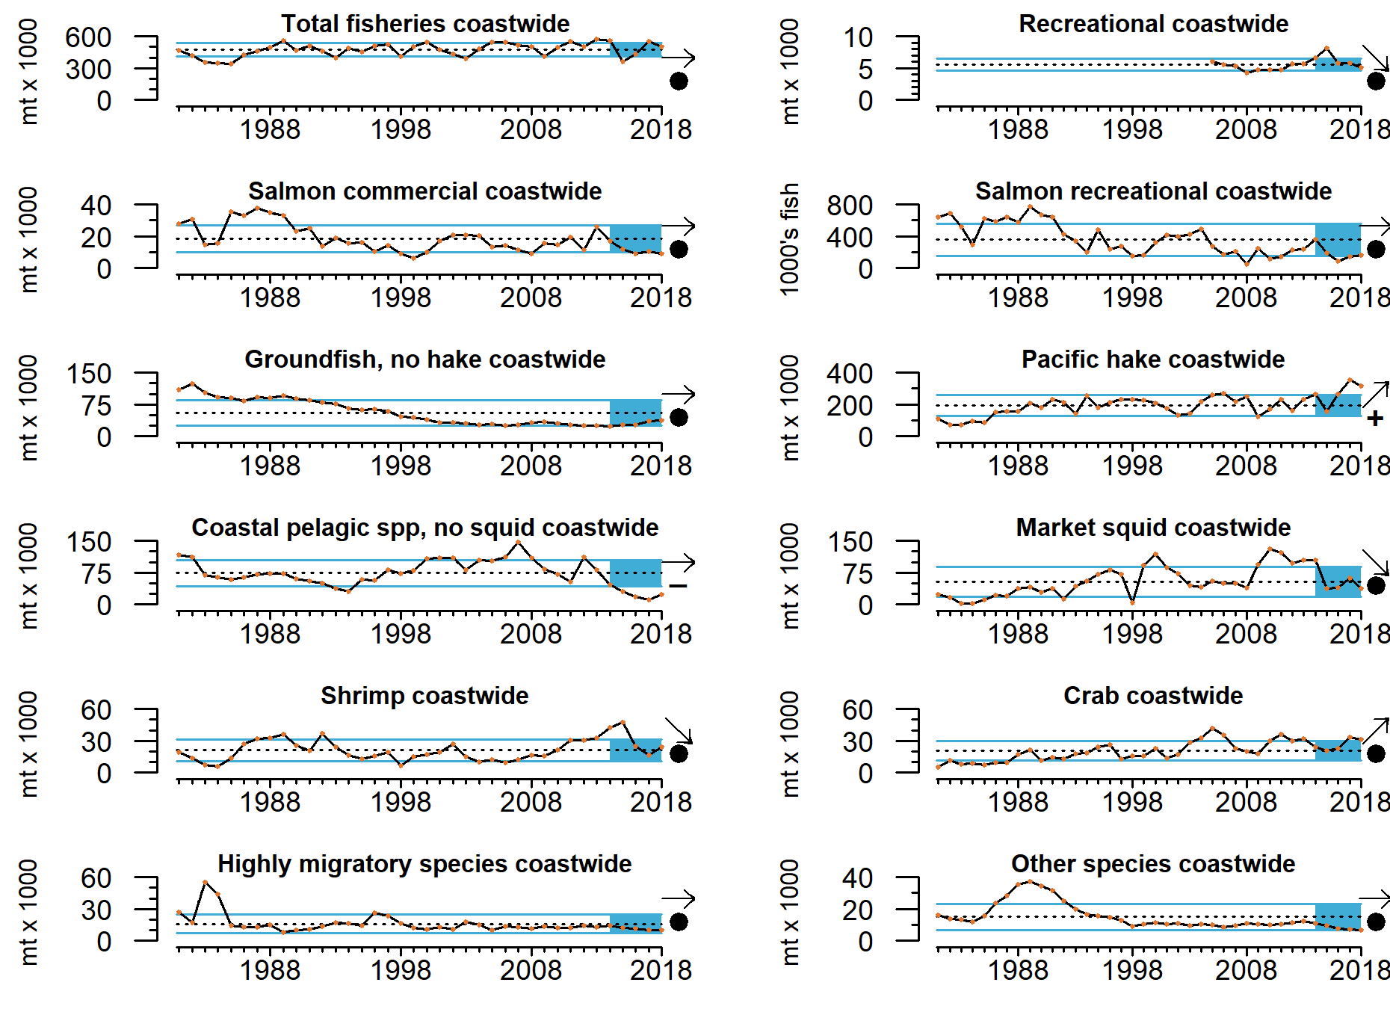
Landings through 2018
Landings data updated through 2018
2019 data compilation not quite complete as of today, should be ready by Council meeting
Landings & revenues down slightly in 2018
8% decrease in landings, 7% decrease in revenue relative to 2017
Hake: 63% of landed weight in 2018
CPS, salmon, groundfish, HMS near time series lows

Slide 24
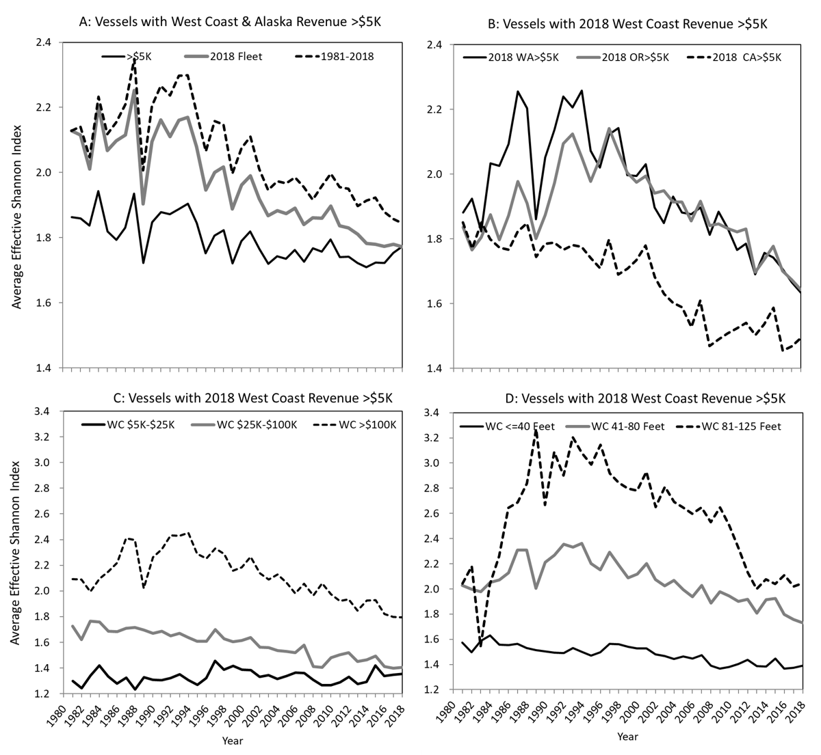
Diversity of vessel revenues still low as of 2018
Index of how broadly and evenly revenue is spread across different fisheries
Lowest score is 1 = all revenue from a single fishery
Diversification remains historically low across all classifications of West Coast vessels
Size, state, total revenue
Little change from 2017 to 2018

Slide 25
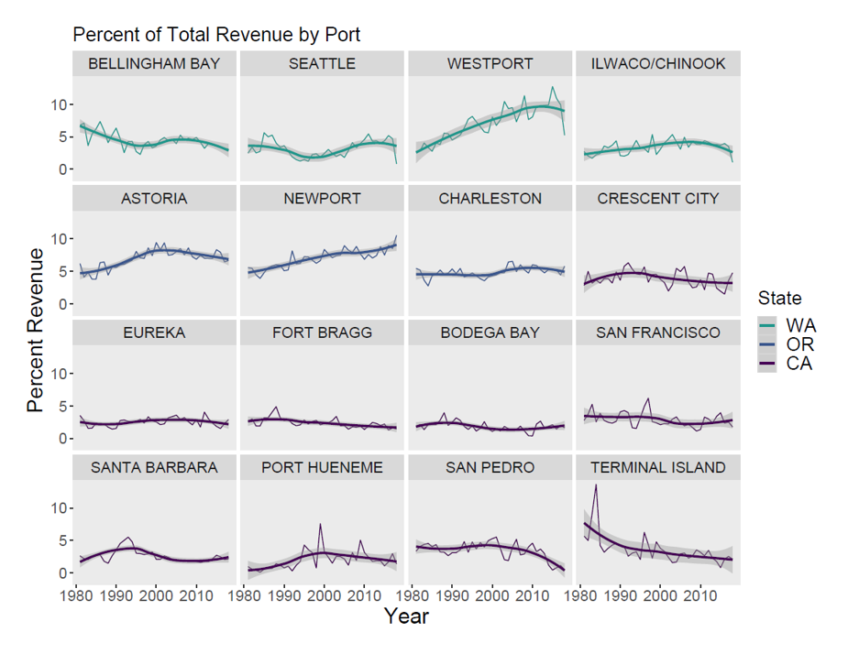
Percent of total commercial fishing revenue by port [Thiell Index of revenue consolidation coming in 2021]
This is a new metric for our report; may relate to consolidation, NS-8
% of total revenue for 16 ports most commonly in the top ranks for landed revenue since 1981
Long-term increases: Westport, Newport
Long-term decreases: Bellingham, Crescent City, Fort Bragg, San Pedro, Terminal Island
Others: stable or variable trends
This will be developed further; feedback welcomed

Slide 26
Social vulnerability

Slide 27
21 IOPAC port groups

Slide 28
Outline
Overview: context within ESR, existing literature
Fuller et al
Sept 2016 review
Methods overview
Emphasize distinctions form what they’ve seen
Meld review of what’s in the paper and what they have seen with how we responded to their recommendations
Initial high level results, eg several example communities 2020 only
Flagging how these fill gaps in ESR
Next deeper results, eg 2020 vs 2016-19 for a few important communities
Horizon pointing
MDS
Diff sp groupings, eg CVA high vs low ranks
Pre post catch shares

Slide 29
Community relationships with fisheries are complex
Social ties among people, vessels , and fisheries connect their dynamics
Notes:
Ecology
mobile —> sedentary
pelagic —> benthic
vertebrate — > invertebrate
Management
ITQs
TACs
Seasonal
Gear
Mobile —> Fixed
Bottom —> Midwater
Selective —> Unselective

